Slide 1
Parte V.1
Tecnologias de Integração
SOA - REST
Instituto Politécnico do Cávado do Ave
Escola Superior de Tecnologia
ESI

Slide 2
REST
Representational State Transfer (by Roy Thomas Fielding)
Arquitectura simples para aplicações distribuídas em rede
Utiliza HTTP para integrar sistemas (em vez de SOAP, XML-RPC, etc.)
Aplicações RESTfull utilizam o protocolo HTTP para operações CRUD
Mais simples e “leve” que os SOAP Web Services (SOAP, WSDL, UDDI, etc.)
Não é um standard
Implementa-se em PHP, JAVA, C#, etc.
Basta uma ligação com HTTP

Slide 3

REST – Web Architecture
Recurso na Web identificado por um ID de recurdo (resource ID)
http://www.ipca.pt
URI
Roy Thomas Fielding
c2
“estado”
“estado”
c4
c1
representa o “estado” do componente externo
$representation = file_get_contents('http://www.ipca.pt/');
c3
Web Architecture: abstraction of a distributed system
Elements: Components, Connections, Data
Component: abstraction of a functional unit of the system
Connection (connector): abstraction of what mediates the interaction between components
Data: abstraction of information that flows between components
c5

Slide 4
REST (vs SOAP Web Services)
Platform Independent (Linux, Windows, Mac, etc.)
Independent of Programming Language (C# "talks" to JAVA, etc.)
Standards-based (HTTP, XML, MIME, URI)
Supports well firewalls
Security with HTTPS
Does not support cookies. The state is transferred in the request
Analogy:
SOAP Web Services ≡ SOAP envelopes (lots of information)
REST ≡ PostCards (little information)

Slide 5
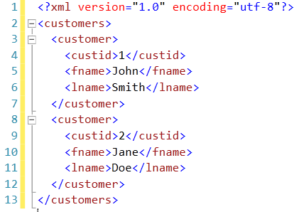
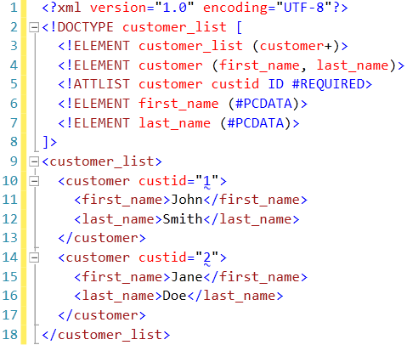
REST
The returned XML is not standard...unlike others (ex.XML_RPC...)
Serviço A
Serviço B

Slide 6
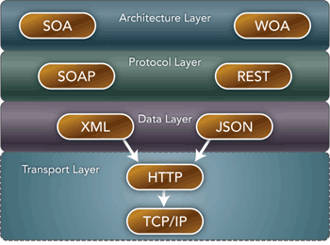
REST and SOAP Web Services
SOA
ROA⁽¹⁾
Security
XML
Maturation
"Serious Issues"
Faster and easier
Streamlined design
Higher performance
Lower bandwidth
⁽¹⁾
ROA - REST Oriented Architecture or Resource Oriented Architecture
WOA – Web Oriented rchitecture
fonte: http://edn.embarcadero.com/article/40467
Notes:
WOA – Web Oriented Architecture

Slide 7
REST
It is an architecture based on the concept of resources. It uses resources to represent the state and functionalities of an application. These resources are identified by URIs (Uniform Resource Identifier) over the HTTP protocol.

Slide 8
REST
Resources (resources identified by a URI)
Web Resources (more detail about the resources)
Components: Client and Server
Stateless Connection (stateless interaction)
Resources subject to caching
Proxies guarantee security, performance and scalability
Not Methods, but Objects and Messages are involved.
Messages: POST (C), GET (R), HEAD, PUT (U), DELETE (D) (CRUD)
See: http://www.w3schools.com/tags/ref_httpmethods.asp

Slide 9
REST
Resources
All the movies of a certain actor
The current value of a certain product
All the photos of Barack Obama on June 1, 2010
The list of products a company sells
Every response is a state; every operation is a transaction;
Static or dynamic resources, mapped to a URI;
Uniform Interfaces (avoids learning new syntaxes).

Slide 10
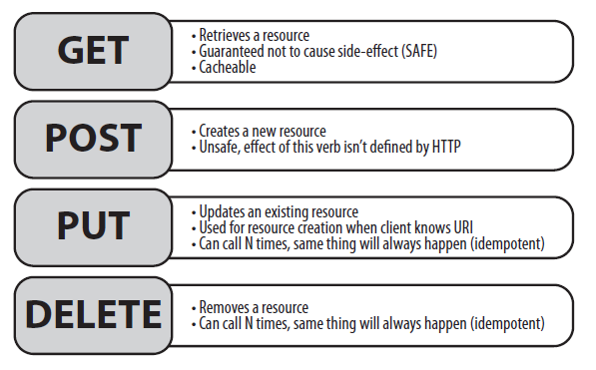
REST Verbs (HTTP verbs)
Data presented in: XML, JSON, HTML, RSS/Atom, OData, Microformats

Slide 11
RESTful versus RESTless
REST is an architecture...SOAP is a protocol!
RESTful conditioned to a set of rules (HATEOAS)*. Only uses URIs...does not require specific syntax like interfaces/IDL....
RESTless....does not respect HATEOAS at all!
See: http://www.programmableweb.com/news/hypermedia-apis-benefits-hateoas/how-to/2014/02/27
* HATEOAS - Hypermedia as the Engine of Application State
Notes:
HATEOAS - Hypermedia As The Engine Of Application State

Slide 12
REST in practice
WCF REST or ASP.NET Web API?
https://docs.microsoft.com/en-us/dotnet/framework/wcf/wcf-and-aspnet-web-api
If you want to do a "simple" REST service then go with WebAPI, hand down. When I say "simple" is architectural simplicity, business wise there’s no limitation. If you want to have a more advanced implementation, supporting SOAP and REST endpoints, or really put your hands on how the communication is done at a lower level, then WCF is the way to go.

Slide 13
REST in practice
Web services with REST API available
Google
(https://developers.google.com/products/)
(https://developers.google.com/maps/web-services/)
Yahoo (https://developer.yahoo.com)
Amazon (https://docs.aws.amazon.com/apigateway/api-reference/)
eBay (https://developer.ebay.com/products/developer)
Bing Maps (https://msdn.microsoft.com/en-us/library/ff701713.aspx)

Slide 14
REST in practice
Web services with REST API available
Twitter (https://dev.twitter.com/rest/public) (https://dev.twitter.com/rest/public/search)
(https://developer.twitter.com/en/products/twitter-api/academic-research)
Flickr (http://www.flickr.com/services/api/)
Programmable Web (http://www.programmableweb.com/api-university)

Slide 15
REST in practice
Implemented in PHP, JAVA, Python, C#, etc…
Steps:
Identify Rest Server (URL)
Identify objects (parameters) to expose (URI)
Interpret result (XML, JSON, other)

Slide 16
REST in practice
Example of URI:
http://api.openweathermap.org/data/2.5/weather?q={CIDADE}&appid={API}
Build URI
Prepare Request
Execute Request and Parse Response in XML/JSON

Slide 17
Using REST in C# (Client)
Find the REST API
http://api.openweathermap.org/data/2.5/weather?q={CIDADE}&appid={API}
Configure URI
uri.AppendFormat("{0}={1}", parameter, HttpUtility.UrlEncode(value));
Create/Prepare request
HttpWebRequest request = WebRequest.Create(uri.ToString()) as HttpWebRequest;
Send Request Order and Handle Response
HttpWebResponse response = request.GetResponse() as HttpWebResponse

Slide 18

WCF REST Services (Service)
Desenvolver WCF Services para serem utilizados via RESTful
(https://msdn.microsoft.com/en-us/library/dd203052.aspx)
Receita:
Incluir System.ServiceModel.Web
Criar WCF Service
Definir no Interface a assinatura dos Serviços
[OperationContract] + [WebGet] ou [WebInvoke]
WebGet - Serviços para HTTP GET
WebInvoke - Serviços para HTTP GET, PUT, POST e DELETE

Slide 19


WCF REST Services
Parameter the WebGet /WebInvoke
ResponseFormat = WebMessageFormat.Json | WebMessageFormat.Xml
UriTemplate
localhost/testservice/GetHotelById/2
localhost/testservice/Hotel/2

Slide 20
WCF REST Services: Web Config
Declare the Service and Endpoint
Declare the Service Behavior
Declare the Endpoint Behavior

Slide 21
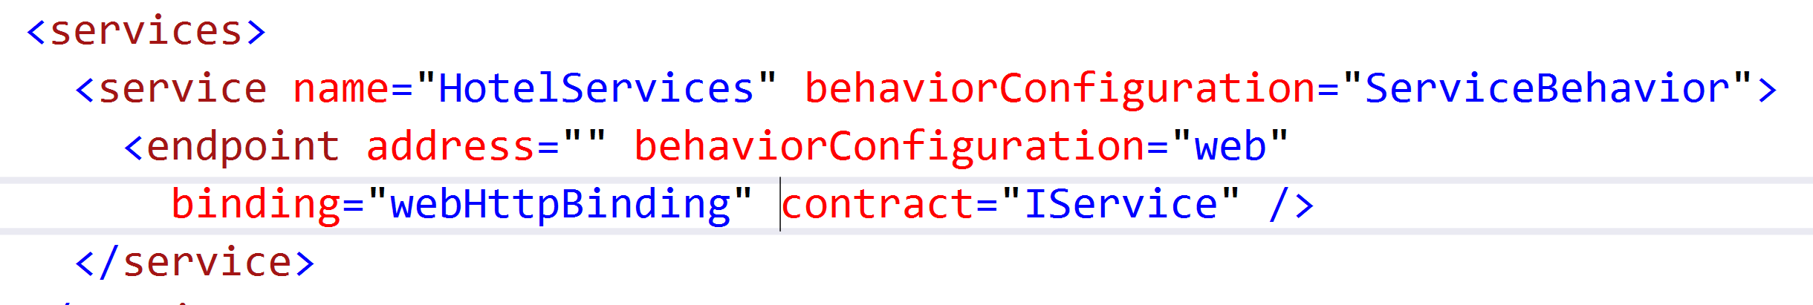
WCF REST Services: Web Config
Change WebConfig: Services
Nome da Classe
Nome do Interface
RESTful - webHttpBinding
SOAP - basicHttpBinding

Slide 22
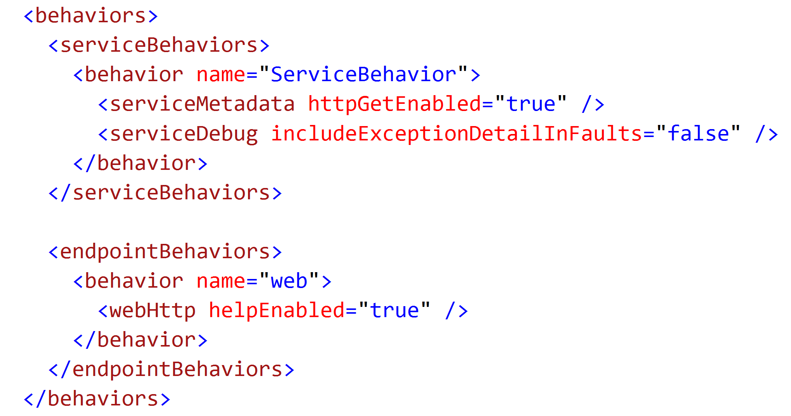
WCF REST Services: Web Config
Change WebConfig: Behaviors

Slide 23
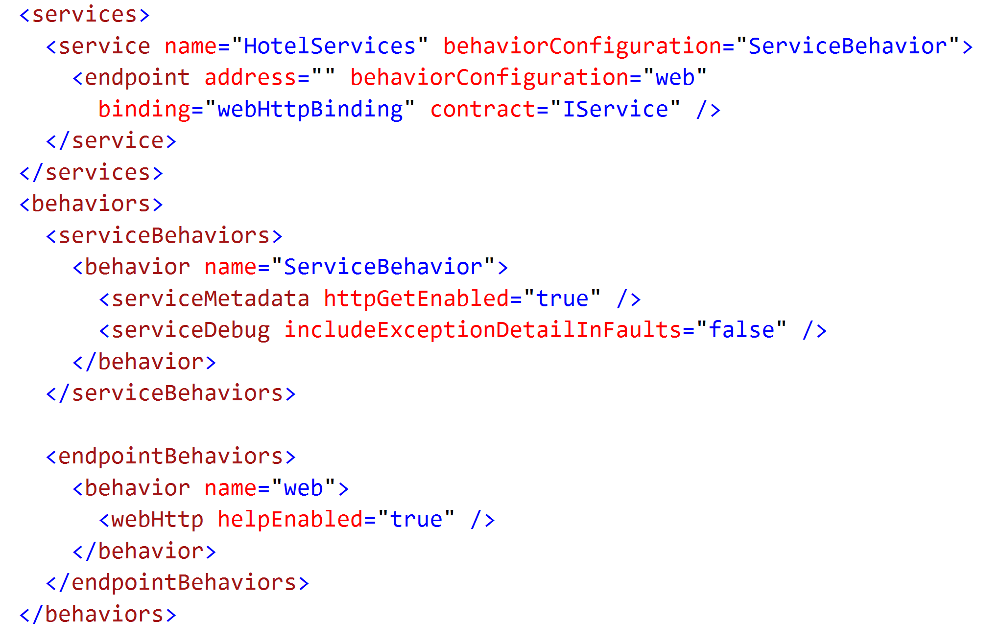
WCF REST Services: Web Config
Resume: WebConfig

Slide 24
WCF REST Services (Alternative)
Delete <system.serviceModel> in Web.Config
Change in markup of Service.svc
Factory="System.ServiceModel.Activation.WebServiceHostFactory"

Slide 25
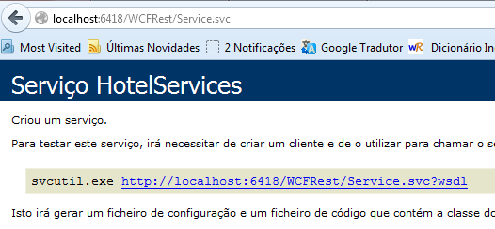
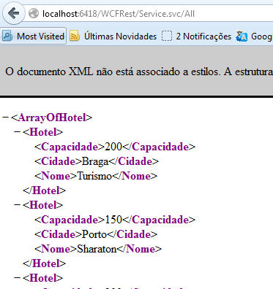
WCF REST Services
Testing

Slide 26
WCF REST Services
Analisar URIs disponíveis
No web.config colocar
<behavior name="web">
<webHttp helpEnabled="true" />
</behavior>
http://localhost:6418/Service.svc/help

Slide 27
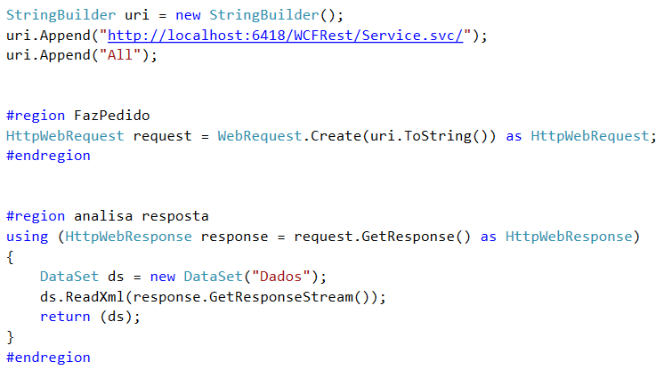
WCF REST Services (Cliente)
Using (if returning XML)

Slide 28
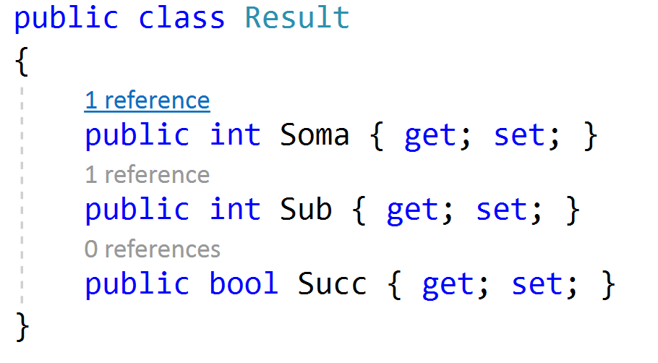
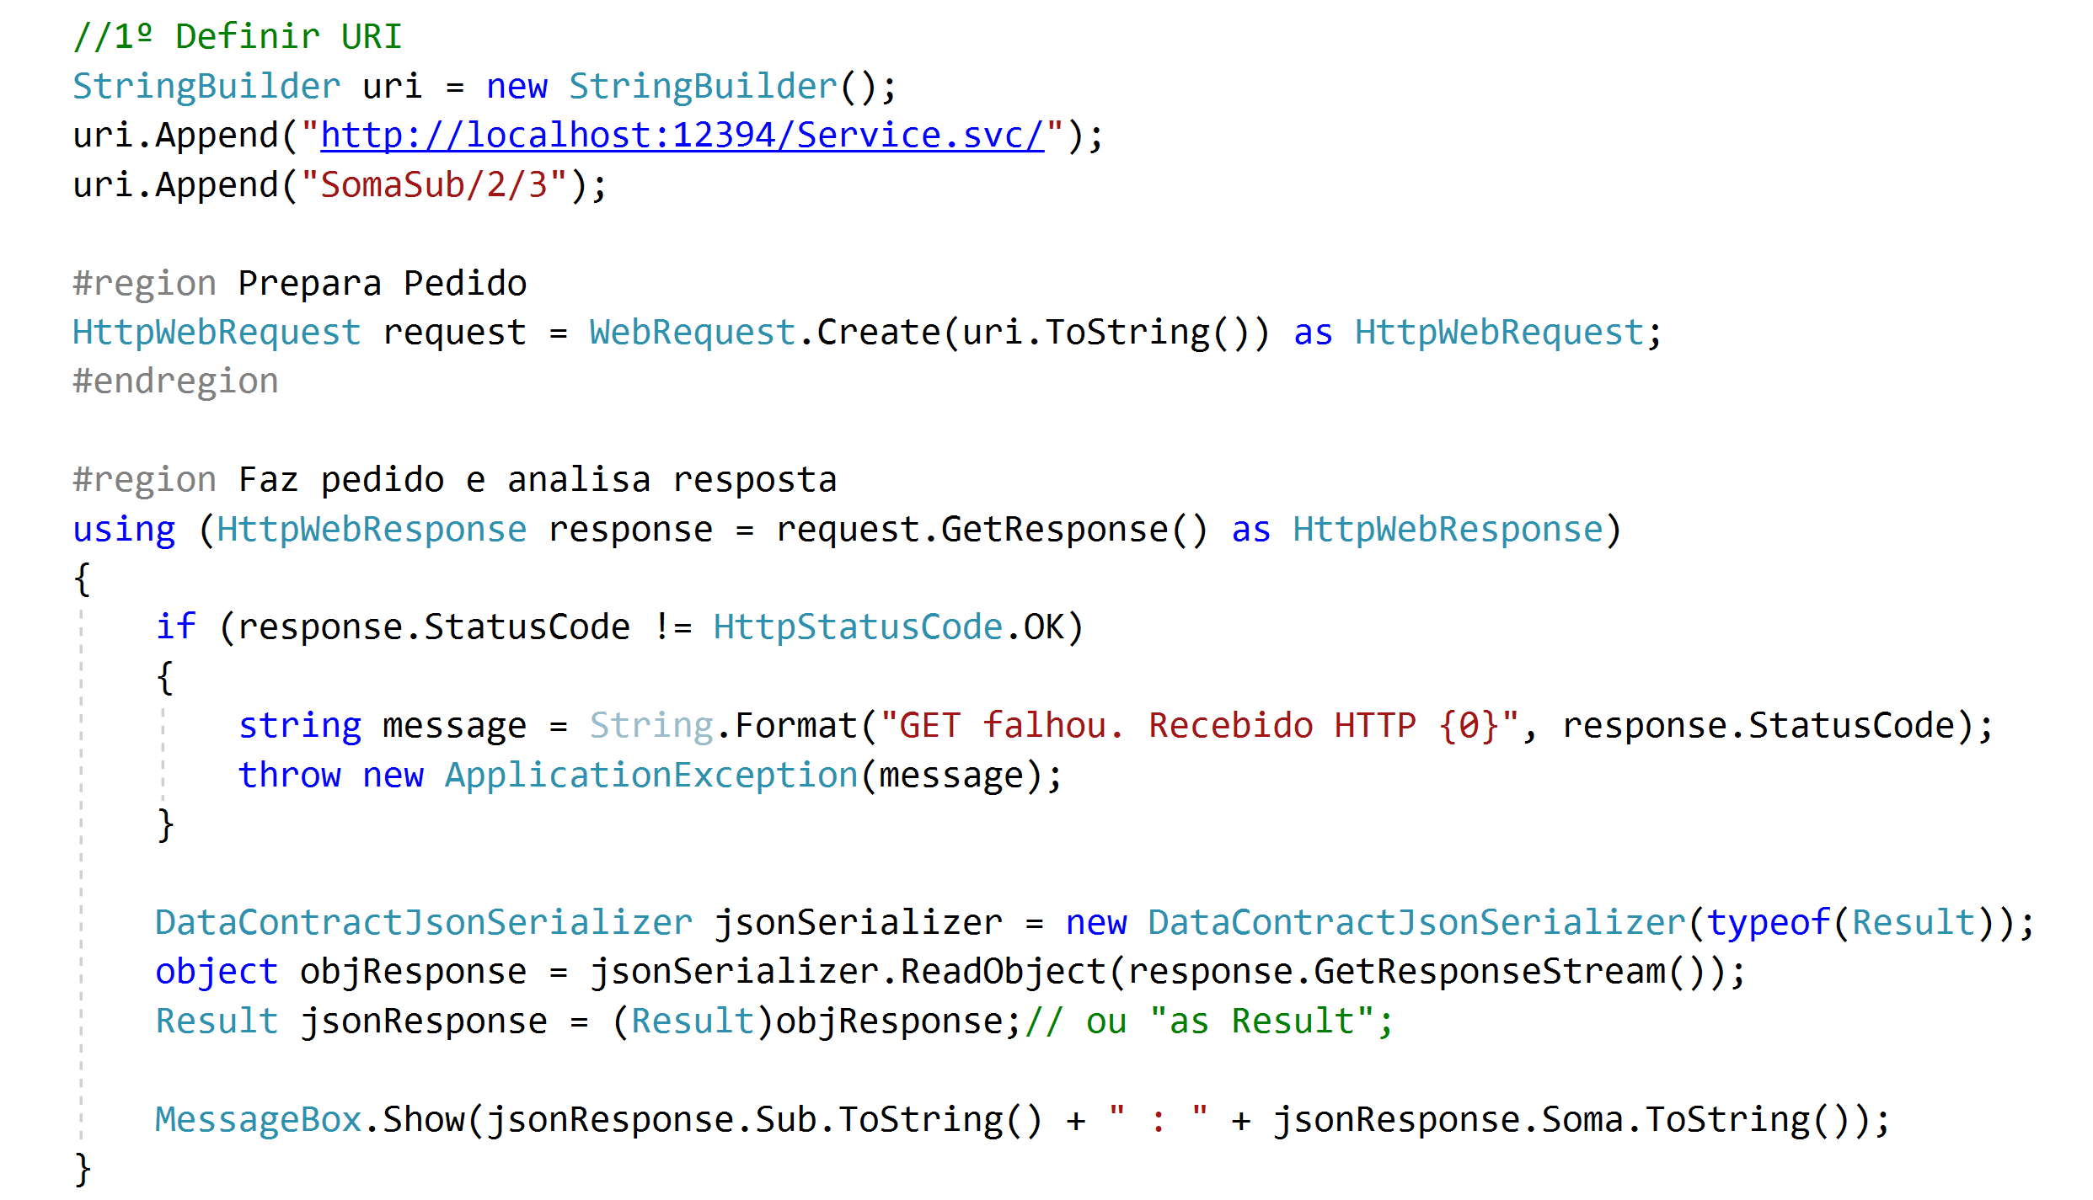
WCF REST Services (Cliente)
Using (if returning JSON)

Slide 29
WCF REST Services (Client via PowerShell)
Start Win Powershell
PS C:\Users\lufer> Invoke-WebRequest -Uri http://localhost:6418/Service.svc/All
PS C:\Users\lufer> Invoke-WebRequest -Uri "http://localhost:6418/Service.svc/All" | select Content

Slide 30
Referências
REST
http://rest.elkstein.org/2008/02/what-is-rest.html
http://www.ics.uci.edu/~fielding/pubs/dissertation/rest_arch_style.htm
Outros
http://www.codeproject.com/Tips/497123/How-to-make-REST-requests-with-Csharp
http://www.codeproject.com/Articles/201901/CREATE-RESTful-WCF-Service-API-Using-POST-Step-By

Slide 31
Mais Referências
https://www.infoworld.com/article/3061973/application-development/how-to-create-a-restful-service-in-wcf.html
http://www.codeproject.com/Articles/105273/Create-RESTful-WCF-Service-API-Step-By-Step-Guide
http://www.codeproject.com/Articles/21174/Everything-About-REST-Web-Services-What-and-How-Pa
Artigo : “A web services primer”
http://webservices.xml.com/pub/a/ws/2001/04/04/webservices/index.html

